Slide 1
Data Management @ Materials Project
Patrick Huck
Lawrence Berkeley National Laboratory
Staff Software Engineer
http://perssongroup.lbl.gov
[PhD High Energy Nuclear Physics, STAR@RHIC]
Special thanks to Shreyas Cholia, Dan Gunter, Anubhav Jain, Shyue Ping Ong and the Materials Project team

Slide 2


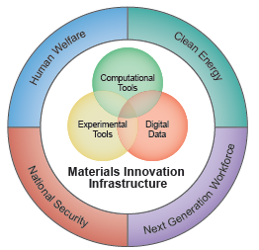
MGI & Materials Project: Achievements to Date
2011: “make the process of discovery & development of advanced materials faster, less expensive, more predictable”
“solutions in most pressing areas require advanced materials”
High-Quality Materials DATA
> 70,000 relaxed compounds: validated energy, phase diagrams
> 70,000 Pourbaix diagrams: world’s largest set
> 43,000 band structures + higher accuracy 2,700 band gaps
> 3,000 elastic tensors: world’s largest data set
Rapid DISSEMINATION
Ten Apps enabling material searching and design
First Materials data API ; community download > 8 million data
MPContribs framework: platform for data sharing
Over 20,000 registered users !
DESIGN
Design of novel functional materials
(photocatalysts, thermoelectrics, cathodes/electrolytes)
Notes:
Unprecedented data collections, analysis and workflow capabilities which are freely available through open source agreements, and started to set the standards for computed data dissemination.

Slide 3
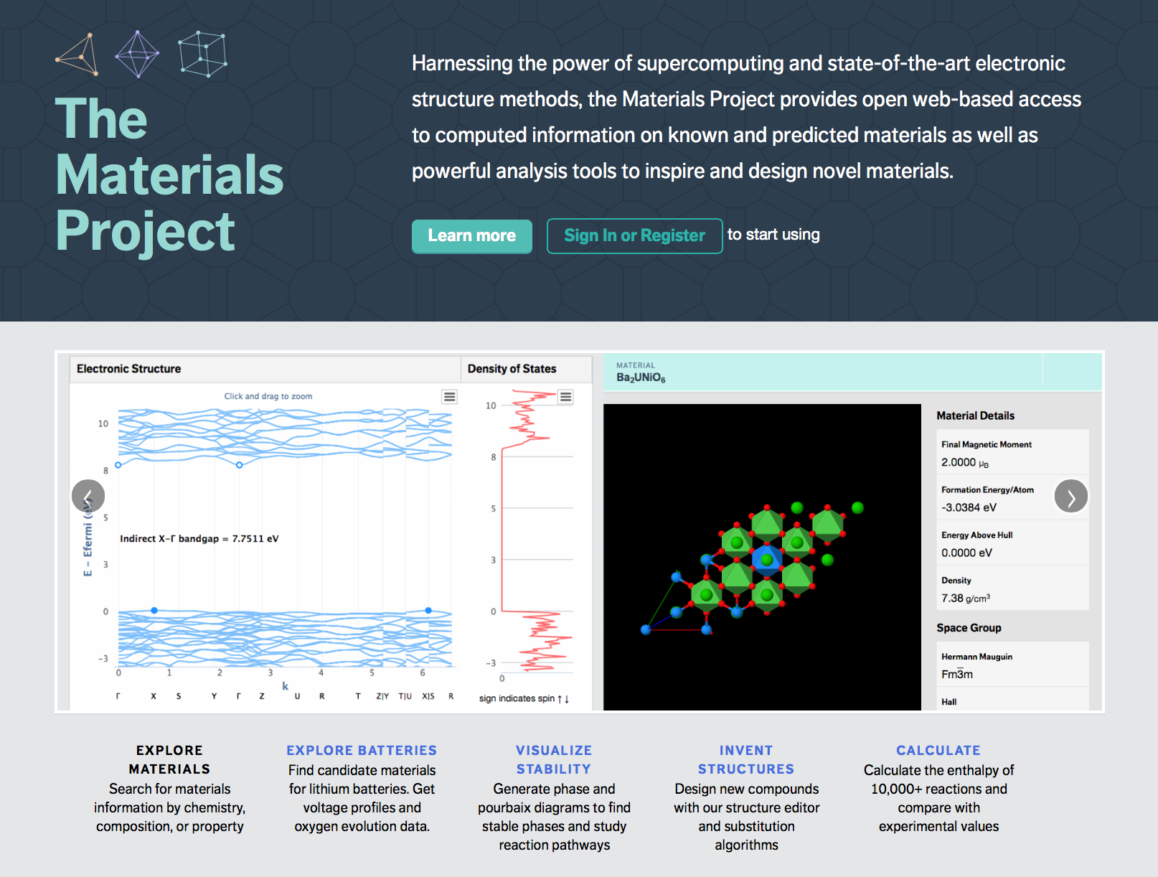
MP Web Site – A Science Gateway
https://materialsproject.org/
https://github.com/materialsproject
State-of-the-art OPEN SOURCE CODES
Developed and disseminated key code base:
FireWorks workflow
pymatgen; comprehensive analysis code
Custodian failure recovery

Slide 4


MGI Informatics "Molecule"
webtzite
Analysis and input file generation
REST API
Data Dissemination
Analysis codes
Manage workflow
Custodian
Workflows and Data Pipelines
Stops job before wall time
Data Curation
MPComplete
Pymatgen-db
Community Contribution
Database insertion
MPContribs
MPCite

Slide 5
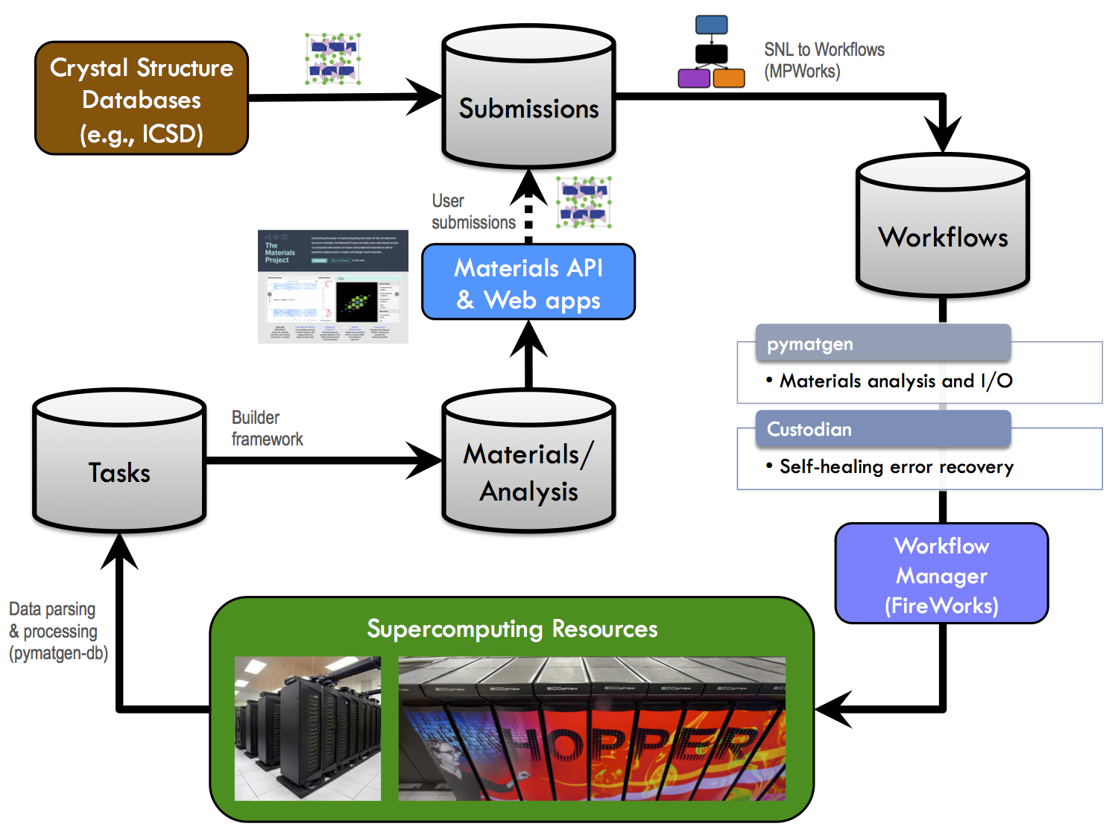
MPComplete
Pipeline driven by Database interactions

Slide 6
Why did we choose MongoDB?
Main advantages
Main disadvantages
flexible
dynamic documents
no schema
developer-friendly
data model is isomorphic to Python dict, and web-standard JSON
queries don't require complicated SQL
fast & scalable
single server is OK for us
replication/sharding* built in
all enforcement of data integrity must be done in code
{e_above_hull: 'blueberry'} looks good to MongoDB
cross-document operations harder than in SQL (but possible)
some operations (joins) may be slower
meta: have to keep justifying ourselves ☺
* Divide data and distribute over multiple servers

Slide 7
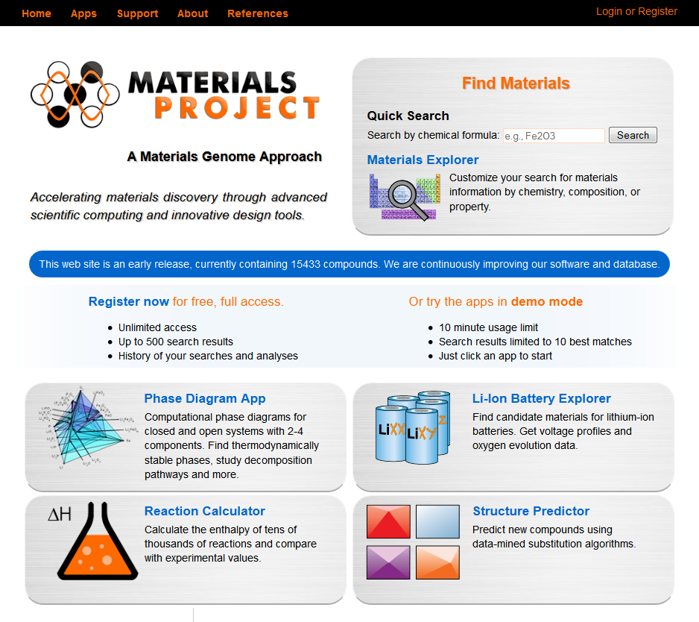




We use MongoDB for everything™
Workflow engine
MongoDB
Web server host
Apps
Calculations

Slide 8
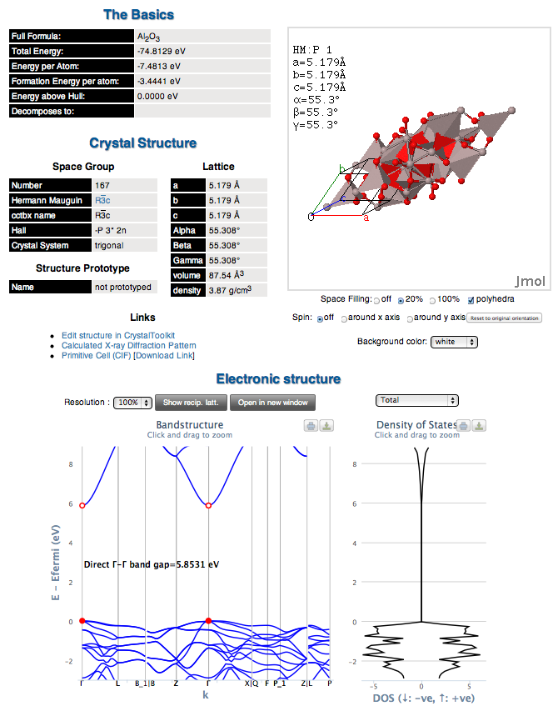
Getting crystal properties requires many distinct calculations
Al₂O₃
Structure/Energy
Static
Band structure
DOS

Slide 9


Workflow requirements
Detours
(about 20% of jobs fail and must be rerun with different input parameters)
Branches
(based on the result of a calculation, the entire workflow might need to be modified)
Duplicate Job detection
(if two workflows contain an identical step,
ensure that the step is only run once)
A
A

Slide 10
FireWorks workflow: basic ideas
Each computation is specified as a dict that can be stored in Mongo
the structure/crystal data as a dict
Job parameters, e.g. INCAR settings, via dict
Reusable Python objects add logic to the jobs
How to override settings based on the output of previous jobs
How to determine if a job succeeded
The Python objects are also serializable as dict, everything about the job is stored in MongoDB
Document in MongoDB collection is isomorphic to Python "dict" data structure.

Slide 11








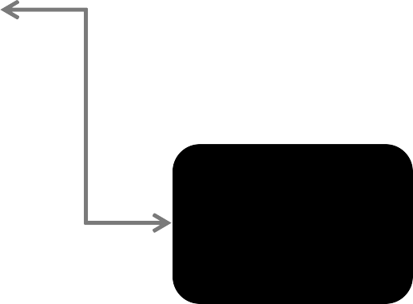

The as_dict() and from_dict() protocol
Almost all non-trivial objects in pymatgen/FireWorks support the as_dict() and from_dict() serialization protocol
Object.as_dict()
json.dump/load
Pymatgen Object, e.g., Structure
Pymatgen dict of primitives
JSON
file/response
pymongo
Object.from_dict()
{u'lattice': {u'a': 2.872, u'gamma':
Structure.from_spacegroup("Pm-3m",
Database, e.g., MongoDB
Lattice.cubic(2.872), ["Fe"], [[0, 0, 0]])
90.0, u'c': 2.872, u'b': 2.872,
u'matrix': [[2.872, 0.0, 0.0], [0.0,
2.872, 0.0], [0.0, 0.0, 2.872]],
u'volume': 23.689358847999998,
u'alpha': 90.0, u'beta': 90.0},
u'sites': [{u'properties': {}, u'abc':
[0.0, 0.0, 0.0], u'xyz': [0.0, 0.0,
0.0], u'species': [{u'occu': 1,
u'element': u'Fe'}], u'label': u'Fe'}], u'@class': 'Structure', u'@module': 'pymatgen.core.structure'}

Slide 12
How is MongoDB used in the Materials Project?
Recall: MongoDB databases contains collections of documents
Each logical unit of calculation or analysis or material is a document in a collection.
Collection name | Document description
tasks | Results of a single first principles calculation, be it a relaxation, static or bandstructure calculation
materials | Summary of computed information about a material formed by aggregating all tasks of a crystal structure.
(bandstructures, phasediagrams, batteries, etc.) | Documents representing results of various types of analyses. E.g., a battery document is formed by combining several materials (e.g., FePO4 and LiFePO4) to represent an intercalation system with associated properties like voltage, capacity, etc.

Slide 13
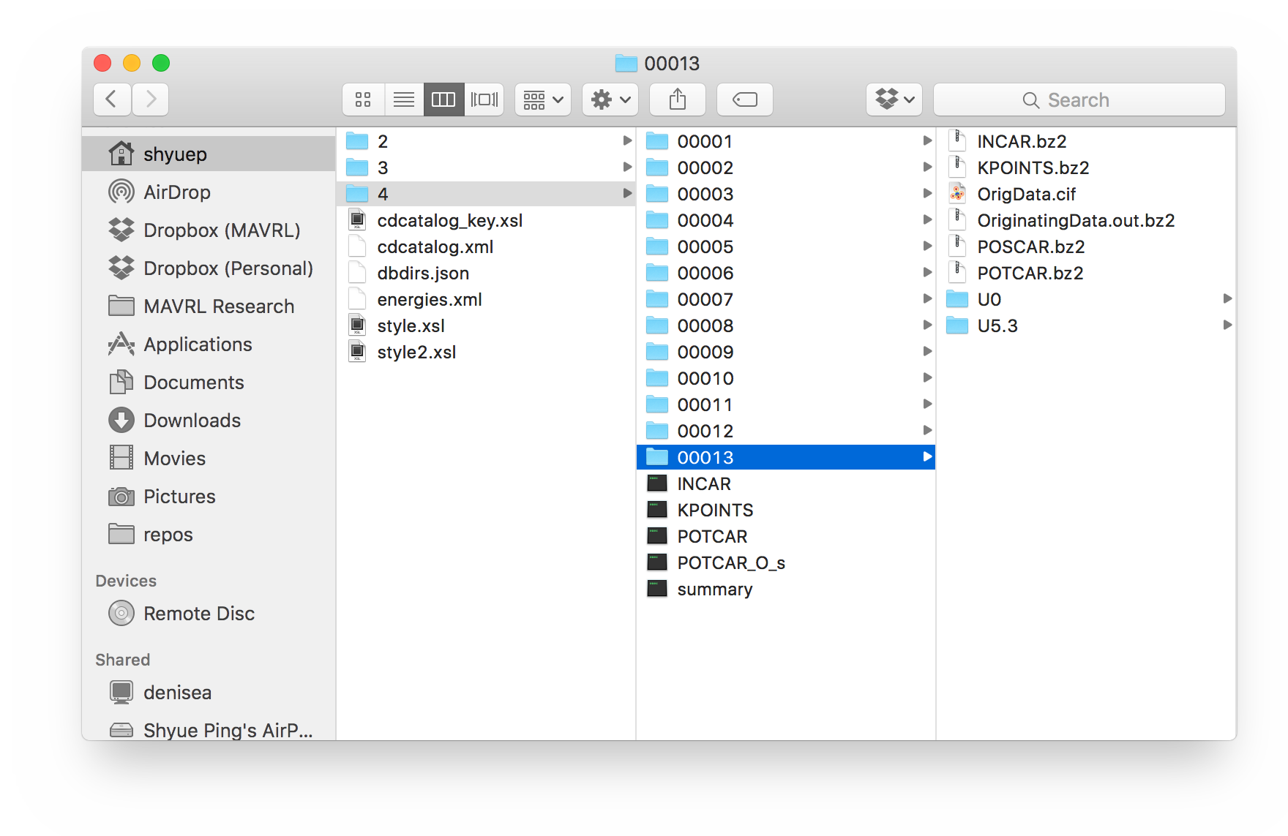
Why do I need a database?
The ”Results” directory of a famously well-organized former graduate student for his very first PhD project:“The Li-Fe-P- O2 phase diagram”

Slide 14





Why do I need a database?
Store pertinent results and analyses
Anything more than O(10) calculations, a DB is useful.
Some analyses are expensive
Sharing
Dropbox is great, but not really a long-term solution for sharing lots of numeric data.
Pre-requisite for building web applications for team.
Querying and analysis
Years into the future. Even today, MP can recall data calculated during the dark ages of 2011.
if you perform many similar calculations, and you need some proper way to manage and analyze this data (note: compiling calculations in a spreadsheet does not constitute proper data management!), it is well worth taking the time to learn MongoDB

Slide 15
What is The Materials API?
We quickly found that scientists wanted programmatic access to data
➨ make your data available through an API and people will start to do amazing things
An open platform for accessing Materials Project data over the web.
Flexible and scalable to cater to large number of collaborators, with different access privileges.
Simple to use and code agnostic.

Slide 16
Materials API in a nutshell
Modern way to expose data resource
(RESTful) APIs are ”UNIX pipe for databases”
Materials API maps URLs to data objects
Identifier, typically a formula (Fe2O3), id (1234) or chemical system (Li-Fe-O)
Preamble
Property
https://www.materialsproject.org/rest/v1/materials/Fe2O3/vasp/energy
Request type
Data type (vasp, exp, etc.)

Slide 17
Sample JSON output
GET https://www.materialsproject.org/rest/v1/materials/Fe2O3/vasp/energy
{
"created_at": "2013-03-17T09:14:58.158081",
"valid_response": true,
"version": {
"pymatgen": "2.5.4",
"db": "2013.02.25",
"rest": "1.0"
},
"response": [{
"energy": -132.33005625,
"material_id": 542309
}, {
"energy": -66.62512425,
"material_id": 24972
}],
"copyright": "Copyright 2012, The Materials Project"
}
Just the energy and the
id of the material
Notes:
Call returns well structured data object

Slide 18
API Considerations
Access to data as well defined objects allows users to develop their own custom applications and code Enables a thriving community built around the data.
To maintain privileged access, each user has an associated API key (with certain defined access privileges)
All MP https requests must supply API key as:
A x-api-key header, e.g., {‘X-API-KEY’: ‘MYKEY’}, or
As a GET or POST variable, e.g., {‘API_KEY’: ‘MYKEY’}
Don’t worry too much about pure REST
Initially just think of how URLs and verbs can map to functions
Don’t worry too much about data formats
JSON is easy and a great place to start
Feel free to avoid XML unless you really need it

Slide 19
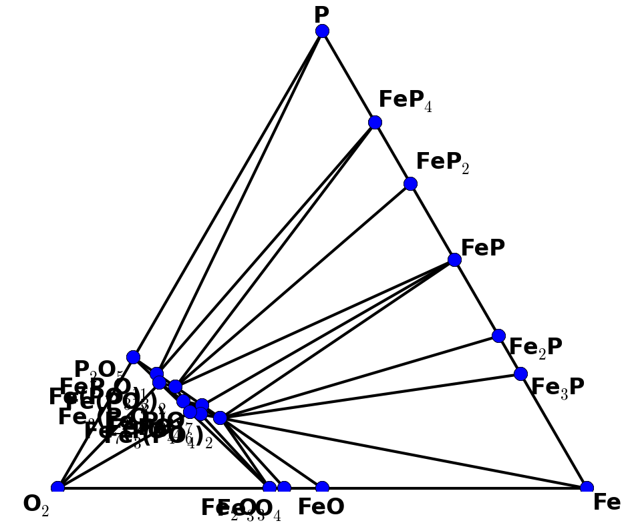
Load, analyze, explore in pymatgen
from pymatgen import MPRester
from pymatgen.phasediagram.pdmaker import PhaseDiagram
from pymatgen.phasediagram.plotter import PDPlotter
if __name__ == "__main__":
MAPI_KEY = None # Change this to your key
system = ["Fe", "P", "O”]
mpr = MPRester(MAPI_KEY) # REST connector
# Gather data
entries = mpr.get_entries_in_chemsys(system)
# Do analysis
pd = PhaseDiagram(entries)
# Plot!
plotter = PDPlotter(pd, show_unstable=False)
plotter.show()
for more - http://gist.github.com/computron
http://gist.github.com/shyuep

Slide 20



The infrastructure allows us to be collaborative and scale beyond ourselves
Code
Code
Code
Code
Paper
vs.
Paper
Paper
Paper
Paper
Paper
Paper
Paper
Paper
Paper
Paper
Paper
Thanks!

Slide 21
Backup Slides

Slide 22
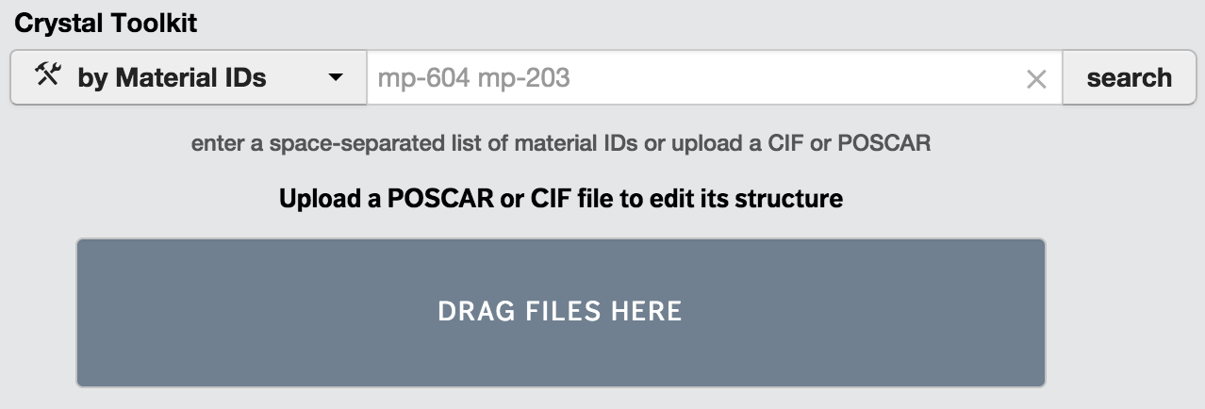
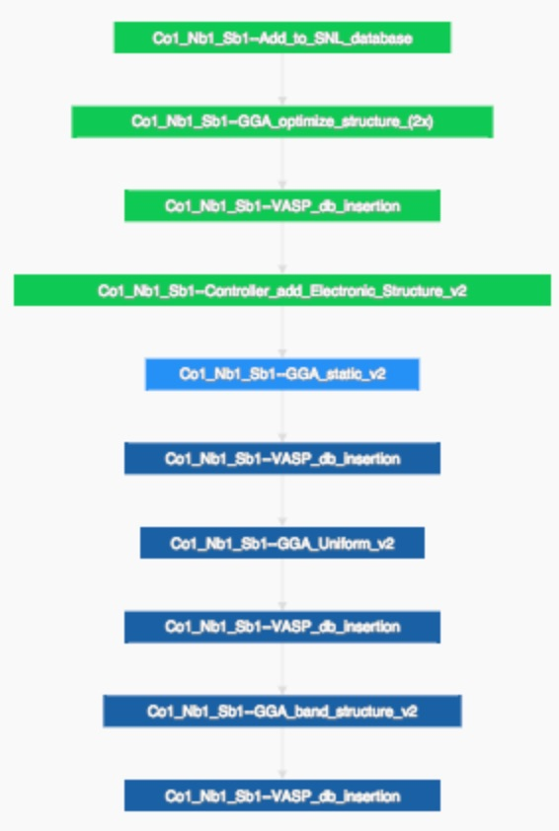
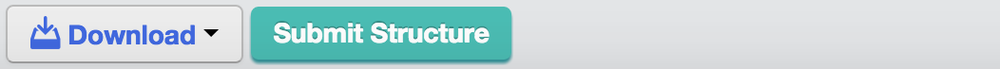
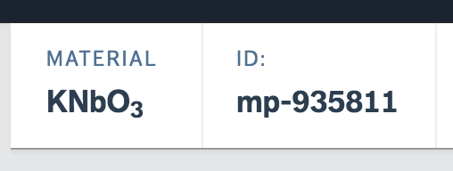
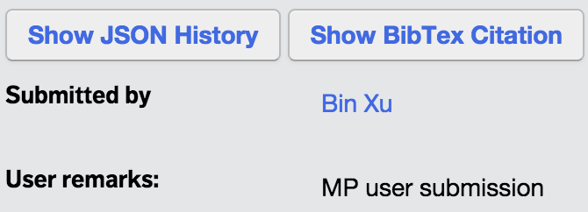

Suggest new structures for calculation by MP
Assigns [new] MP identifier
Runs calculations
Adds material to core database
MPComplete
http://fireworks.dash.materialsproject.org/wf/1445229
https://youtu.be/k6mEA-sDSig
Center Resources
Notes:
An example for user contribution to the MP database: MPComplete.
MPComplete is a tool we developed that allows users to contribute to Materials Project by submission of user crystal structures for calculation within the Materials Project workflow. A flexible interface allows users to easily upload their crystal structure, edit within their internet browser, and submit the structure for calculation with “one click” of a button.
Each new submission gets a unique MP identifier, is calculated with the regular MP workflow, and the results are added to the core database. Users can access the results of their submissions through their “Dashboard” on the website, and the results are also become immediately available to thousands of MP users through the website.

